Slide 1
Introduction to Linux and Shell Commands
Course Level – Intermediate

Slide 2
About the Course Creators
Course Name | Introduction to Linux and Shell Commands
Course Author Name : | Senathipathi K
About the Author : | Senior Technical Trainer- L&D
Date of Creation | 09-Nov-2023

Slide 3
After completing this course, the participants will be able:
to understand What is Linux.
to understand the Architecture of Linux operating System.
to understand How Linux differs from other operating Systems.
To understand the different shell commands and its use.
Course Learning Objectives

Slide 4
What is Linux?
What is the architecture of the Linux OS?
How Linux is different from Unix operating system?
What are the different shell commands and its use.
Do You Know?

Slide 5
Pre-Test
S.No | Question | Answer Options
1 | Linux is a ________________ operating system. | a) Free & Open source b) Proprietary c) Single User d) None of the above
2 | Who developed Linux? | a) Dennis Ritchie b) Ken Thomson c) Linus Torvalds d) None of the above

Slide 6
Pre-Test
S.No | Question | Answer Options
3 | What are the advantages of Linux over Unix? | a) Open Source b) Supports large set of file systems c) Both a & b d) None of the above
4 | Shell command “pwd” is used to ___________ | a) To display the present working directory. b) To display the password. c) To change the password. d) None of the above

Slide 7
Introduction to Linux

Slide 8
Free and Open source, Unix like operating system based on Linux Kernel released by Linus Torvalds.
Source code can be modified and redistributed under GNU GPL.
Originally developed for Personal computer use but gradually it was used in other machines as well.
Android is most important success of Linux operating system. It was developed based on Linux Kernel which is widely used in Smartphones and Tablets.
It is used in embedded systems like Televisions, Smartphones, routers and automation controls.
90% of cloud infrastructure and 70-80% of smartphones are powered by Linux.
What is Linux?

Slide 9
Linux Distribution:
It is an Operating System developed based on Linux kernel. Linux distribution contains Linux kernel with supporting libraries and other software applications.
Popular variants of Linux distributions are
Ubuntu
Linux Mint
Fedora
Redhat
OpenSUSE
Kali Linux
Popular variants of Linux

Slide 10
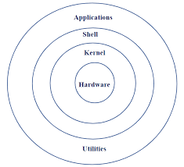
Architecture of Linux Operating System

Slide 11
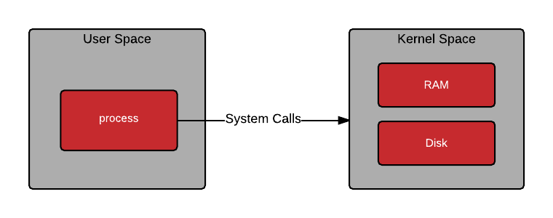
User space is the area of memory for running user processes (non-kernel applications).
Runs in Non-privileged execution mode
Kernel space is the area of memory for running kernel mode instructions.
Runs in Privileged (root -access) mode
User Space and Kernel Space

Slide 12
Free & Open source
Reliability
Large community support
High performance
Supports large file systems
Network friendly
Stability
Security
Advantages of Linux

Slide 13
Linux Vs Unix
 | Linux | Unix
License Type | Free and open source | Commercial
Usage | All types of machines (from mobile devices to large enterprise servers) | Servers, PCs and Workstations
Variants | Ubuntu, RedHat, OpenSUSE etc | IBM AIX, HP-UX and Solaris
File System Support | Supports large file systems like Ext2, Ext3, Ext4, FAT, FAT32, NTFS etc | fs, gpfs,hfs, hfs+,ufs,xfs,zfs
Community Support | Large community support for frequent software updates | Limited community for specific goal
GUI | KDE and Gnome | Initially Command based but later Gnome GUI

Slide 14
Linux Vs Windows
 | Linux | Windows
License Type | Free and open source. (written in Assembly language and C) | Commercial (written in Assembly language and C++)
Web server Usage | 70-80% of Web servers are using Linux OS | 20-30% Web servers are only using Windows OS
File System Support | Supports large file systems like Ext2, Ext3, Ext4, FAT, FAT32, NTFS etc | NTFS, FAT,ISO 9660,UDF, HFS
Security | Linux is more secured and hard to breakthrough | Windows is less secure. Attackers primarily target the Windows for malware and virus.
Reliability | Highly reliable and secure | Not much reliable as Linux
Ease of Use | Linux is meant to be for Technical users | It comes with simple & rich GUI options

Slide 15
Basic Shell Commands

Slide 16
Shell is a program which allows the user to interact and use operating system services.
It acts an interface between the user and the operating system.
It accepts the user commands and converts them into kernel understandable form for execution
What is a Shell?

Slide 17
Linux has different variety of shells.
Bourne Shell
C Shell
Korn Shell
Debian almquist shell
Bourne Again Shell
Z Shell
Fish Shell
Different Shells in Linux

Slide 18
Different Shells in Linux
Bourne Shell (sh) | First default shell. Compact and fast but lacks in standard features | Root prompt - # User prompt - $
C Shell (csh) | Interactive but has syntax inconsistencies | Root prompt - # User prompt - %
Korn Shell (ksh) | Includes features of sh and csh. Supports programming features. | Root prompt - # User prompt - $
Debian almquist shell (dash) | Famous default shell for Ubuntu and Debian. 4x faster than other shells. Requires minimal memory space | Root prompt - # User prompt - $
Bourne Again Shell (bash) | Default shell for many Linux distributions. Incorporated useful features of Korn Shell and C Shell | Root prompt - # User prompt - $

Slide 19
ls command
The ls command lists files and directories in your system.
Syntax:
ls [/directory/folder/path]
Options:
-R – lists all the files in the subdirectories.
-a – shows all files, including hidden ones.
-lh – converts sizes to readable formats, such as MB, GB, and TB.
Basic Shell commands

Slide 20
pwd command
Prints present working directory.
Syntax:
pwd [option]
Options:
-L or -logical – prints environment variable content including symbolic links.
-P or -physical – prints the current directory’s actual path.
Basic Shell commands

Slide 21
cd command :
Used to move from current working directory to different directory.
Syntax:
cd [directoryname]
Basic Shell commands

Slide 22
mkdir command :
Used to create a new directory if not already exists.
Syntax:
mkdir [option] [directoryname]
Options:
-p – creates a directory between two existing folders.
-m – sets the folder permissions.
Basic Shell commands

Slide 23
rmdir command :
Used to delete an empty directory.
Syntax:
rmdir [option] [directoryname]
Option:
-p – removes directories and its ancestors.
Basic Shell commands

Slide 24
rm command :
Used to permanently deletes an files.
Syntax:
rm [option] [filename1] [filename2] [filename3]
Option:
-i – prompts confirmation before deletion.
-f - allows file removal without confirmation
-r - deletes files and directories recursively
Basic Shell commands

Slide 25
cp command:
Copy the files and directories from source path to destination.
Syntax:
cp [option] source_file destination_file
Option:
-i – prompts confirmation before overwriting.
-b - creates backup of the file
-r - allows to copy the entire directory
Basic Shell commands

Slide 26
mv command:
To move or rename the files/directories.
Syntax:
mv [option] source_filename destination_filename
Option:
-i – prompts confirmation before overwriting.
-b - creates backup of the file.
-f - overwrites the destination file forcefully and deletes the source file.
Basic Shell commands

Slide 27
touch command:
To create an empty file in the specified directory path.
Syntax:
touch path/file_name
Basic Shell commands

Slide 28
file command:
To check the file type whether it is image or text or binary.
Syntax:
file file_name
Basic Shell commands

Slide 29
zip & unzip command:
Zip is to compress the items into a zip file.
Unzip is to extract the files from the compressed file.
Syntax:
zip zipfile file_name1 file_name2 file_name3 ….
unzip zipfile.zip
Basic Shell commands

Slide 30
tar command:
To archive multiple items into a TAR file.
Syntax:
tar [options] archive_file file_name1 file_name2…
Option:
-c - creates archive with files and directories.
-x - extracts files and directories from existing archive file.
-u - adds new files and directories within an archive.
Basic Shell commands

Slide 31
nano & vi commands:
To edit the text files using nano/vi text editors.
Syntax:
nano file_name
vi file_name
Basic Shell commands

Slide 32
cat command:
To list or combine or write contents.
Syntax:
cat > file_name - to create a new file
cat file_name1 file_name2 > merged_file - to combine files
cat or tac file_name - to display file contents
Basic Shell commands

Slide 33
grep (global regular expression) command:
To search search a string from the contents of the file .
Syntax:
grep search_text filename
Basic Shell commands

Slide 34
head command:
To print first 10 lines of the text file.
Syntax:
head [option] file
Option:
-n - to specify number of lines to be printed
Basic Shell commands

Slide 35
tail command:
To print last 10 lines of the text file.
Syntax:
tail [option] file
Option:
-n - to specify number of lines to be printed
Basic Shell commands

Slide 36
sort command:
To sort the contents of the file.
Syntax:
sort [option] file
Option:
-o - output to a new file
-r - reverse order
-n - numerical order
-u - sort and remove duplicates
Basic Shell commands

Slide 37
wc command:
To count the number of characters, words in the file.
Syntax:
wc [option] file
Option:
-l - number of lines
-w - number of words
-c - number of bytes
-m - number of characters
Basic Shell commands

Slide 38
locate command:
To locate the a file in a linux system.
Syntax:
locate [option] [filename/pattern]
Option:
-i - ignore case
-c - number of matching entries
-e - existing entries
-w - whole name
Basic Shell commands

Slide 39
useradd command:
To add a new user for Linux system. This command requires sudo privileges.
Syntax:
useradd [option] username
Option:
-u - specify userid
-g - specify groupid
-e - expiry date for user account
Basic Shell commands

Slide 40
userdel command:
To delete an user from the Linux system.
Syntax:
userdel username
Basic Shell commands

Slide 41
Sudo (superuser do) command:
To run user commands with administrator or root privileges.
Syntax:
sudo command
Example:
sudo useradd newuser
Basic Shell commands

Slide 42
su command:
To switch to other user accounts.
Syntax:
su user_account - to switch to user account
su - - to switch to root
Basic Shell commands

Slide 43
chmod command:
To modify the permission for directory or file.
Syntax:
chmod [option] [permission] file_name
Permission:
r - read
w - write
x - execute
Users:
u - owner , g - group , o - others , a - all
Basic Shell commands

Slide 44
chown command:
To change the ownership of the file.
Syntax:
chown owner_name file_name
Basic Shell commands

Slide 45
chgrp command:
To change the group ownership of the file or directory.
Syntax:
chgrp new_grp file/directory
Basic Shell commands

Slide 46
Shell uses pipes to connect input and output streams.
No intermediate files need to be created.
Data can be passed serially.
Symbol “ | ” used as a connector between two commands
Output of one command is input to another command
Pipes ( | )

Slide 47
Prerequisite:
To run Java programs from the command line, a functional Java Runtime Environment is required.
To install Java Runtime Environment on Ubuntu/Debian based systems:
sudo apt install default-jdk
To install Java Runtime Environment on CentOS/RHEL based systems:
sudo yum install java-1.8.0-openjdk
Running Java applications through Shell

Slide 48
Step 1: Write a Java program
Use text editors like vi or nano for creating new java console application.
vi file_name.java
(or)
nano filename.java
Create a simple console based “HelloWorld.java” Application.
Save and exit from the editor
Running Java applications through Shell

Slide 49
Step 2: Compile the Java program
To compile the java program source code in terminal, the “javac” command is used.
javac file_name.java
Running Java applications through Shell

Slide 50
Step 3: Run the Java program
If no error is identified during the step 2 then it has been successfully compiled and ready for the execution. Now we can run the java program using “java” command.
java file_name
Running Java applications through Shell

Slide 51
Prerequisite:
To run dotnet console applications from the command line, a .NET Core 3.1 SDK and Runtime is required.
SDK Installation:
To install the .NET Core SDK:
sudo apt install dotnet-sdk-6.0
The following commands install ASP.NET Core Runtime, which is the most compatible runtime for .NET Core.
sudo apt-get install aspnetcore-runtime-6.0
Running Dotnet Console applications through Shell

Slide 52
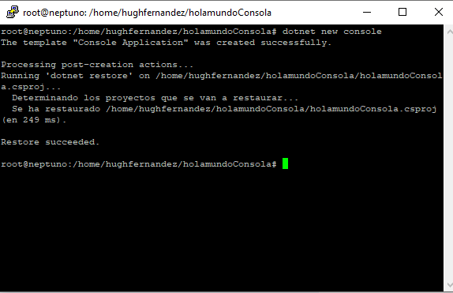
Step 1: Create a simple Dotnet console application
Create a folder where we are going to execute our first application.
Run the following command inside the newly created directory
$ dotnet new console
Running Dotnet Console applications through Shell

Slide 53
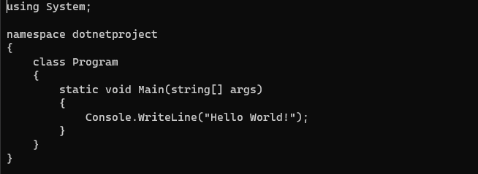
Step 2: Open nano or vi editor to edit the dotnet console application
$ vi Program.cs
Running Dotnet Console applications through Shell

Slide 54
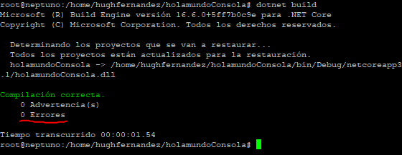
Step 3: Compile dotnet console application
$ dotnet build
Running Dotnet Console applications through Shell

Slide 55
Step 4: Run the dotnet console application
$ dotnet run
Running Dotnet Console applications through Shell

Slide 56

Check Your Understanding
What is Linux?
What is the architecture of the Linux OS?
How Linux is different from Unix operating systems?
What are the different shell commands and its use.

Slide 57

Question & Answer

Slide 58
https://www.geeksforgeeks.org/introduction-to-linux-operating-system/
https://www.geeksforgeeks.org/basic-shell-commands-in-linux/
https://phoenixnap.com/kb/linux-shells
Reference Materials

Slide 59
Senathipathi K

